Slide 1
Basic Digital Signal Processing

Slide 2
Table of content
Signal filtering and enhancement
Point operations
Geometrical operations
Time-domain operations

Slide 3
Signal filtering and enhancement
Signals often need to be processed before using or visualizing them
The goal of signal filtering and enhancement could be:
reducing noise
feature extraction (accentuating certain features of a signal)
detection
signal visualization
We can classify such operations into different groups:
Point operations
Geometrical operations
Time-domain operations
Frequency-domain operations (will be treated in a separate lesson)
Notes:
Operation on Digital signal can be classified in four different groups:
Point operations
Geometrical operation
Time-domain operations
Frequency-domain operations (will be treated in the next lesson)

Slide 4
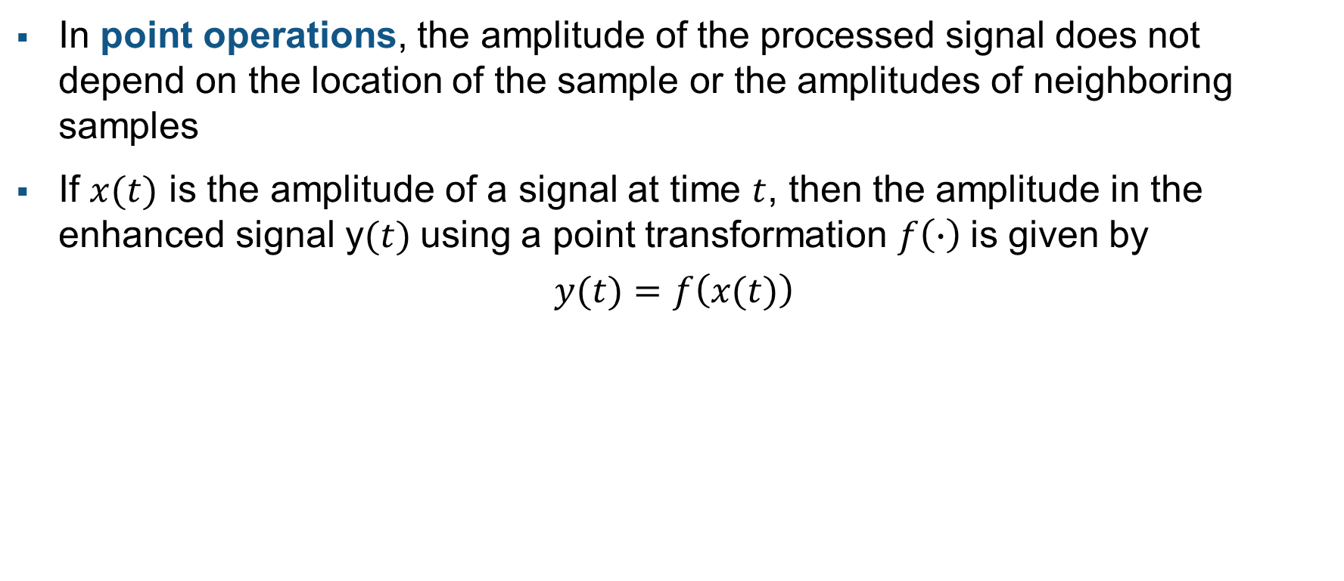
Point operations
In point operations, the amplitude of the processed signal does not depend on the location of the sample or the amplitudes of neighboring samples
If $x(t)$ is the amplitude of a signal at time $t$, then the amplitude in the enhanced signal y$(t)$using a point transformation $f\left(∙\right)$is given by
$$y(t)=f\left(x(t)\right)$$
Notes:
In point operation, the amplitude of the enhanced signal at a certain location, depend only on the amplitude of the original signal at the same location

Slide 5

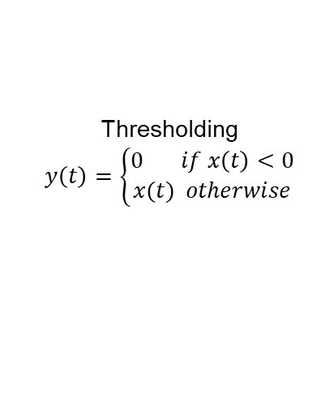

Point operations: examples
Some examples:
Amplitude scaling
$$y\left(t\right)=a∙x(t)$$
Adding bias
$$y\left(t\right)=x\left(t\right)+b$$
Thresholding
$$y\left(t\right)=\left\{\begin{aligned}0 if x\left(t\right)<0 \\ x(t) otherwise\end{aligned}\right.$$
Notes:
Some point operations examples:
Amplitude scaling
Bias
Thresholding

Slide 6

Geometrical operations
Geometrical operations modify the positions of samples in a signal. That is, these techniques operate on the independent variable (e.g. time) of the signal rather than directly operating in the amplitude:
$$y(t)=x(g(t))$$
Notes:
In geometrical operation, the location of the samples of the original signal are changed in the resulting signal.

Slide 7
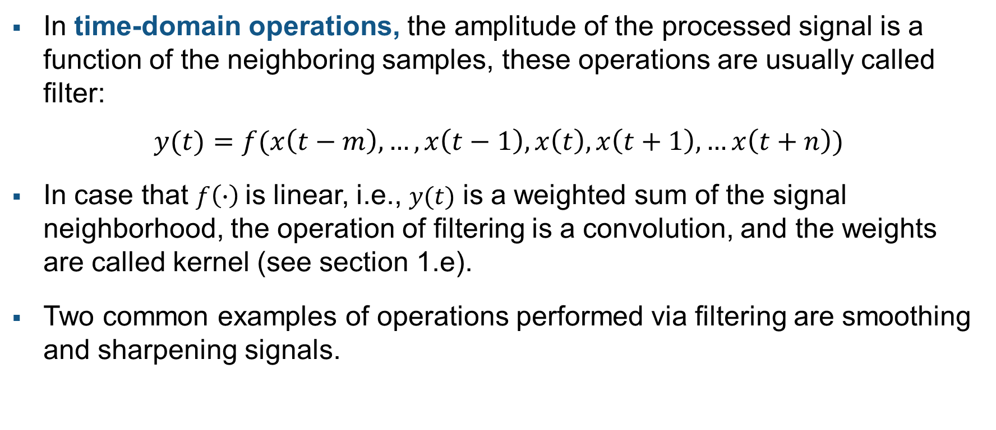
Time-domain operations
In time-domain operations, the amplitude of the processed signal is a function of the neighboring samples, these operations are usually called filter:
$$y(t)=f(x\left(t−m\right),…,x\left(t−1\right),x\left(t\right),x\left(t+1\right),…x\left(t+n\right))$$
In case that $f\left(∙\right)$is linear, i.e., $y(t)$ is a weighted sum of the signal neighborhood, the operation of filtering is a convolution, and the weights are called kernel (see section 1.e).
Two common examples of operations performed via filtering are smoothing and sharpening signals.
Notes:
In time-domain operations, the amplitude of processed signal is a function of the neighboring samples.

